Slide 1

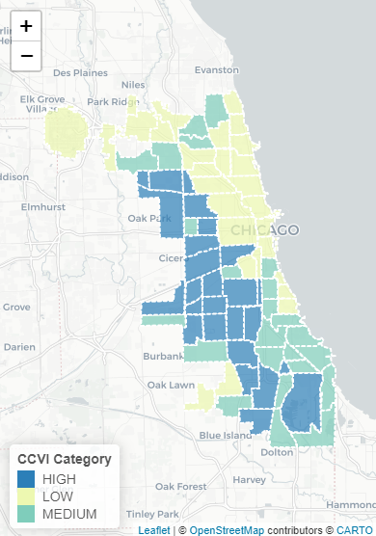
In the space below to copy/paste/insert a custom version (new color palette) of Figure 1 (map of CCVI Scores by Community Area) from the exercise.
GEO 3330 Sustainable Urban Transportation
Exercise #2: L Station Ridership Trends
Describe here any patterns you see in the map. Use data from the map to describe characteristics of at least one community located within each of the three CCVI categories.
Northside communities closest to the lakefront appear to have the lowest vulnerability index values (with the exception of communities like O’Hare, Norwood park and Beverly) Communities further to the west and south, especially those with larger populations of essential workers, appear to have higher CCVI scores.
New City (southwest of the loop) for example, has one of the highest CCVI scores and showcases a large population of essential workers with a very high rate of Covid exposure, hospitalization, and mortality (all above 60). Additionally its high mobility ratio of 72 indicates a high risk of potential exposure from prolonged and far communities.
New city includes Canaryville and Back of the Yards, both historically low-income, industrial communities with high rates of potential comorbidities (Stock Yards waste and industrial activity lowering air, water, and soil quality).

Slide 2
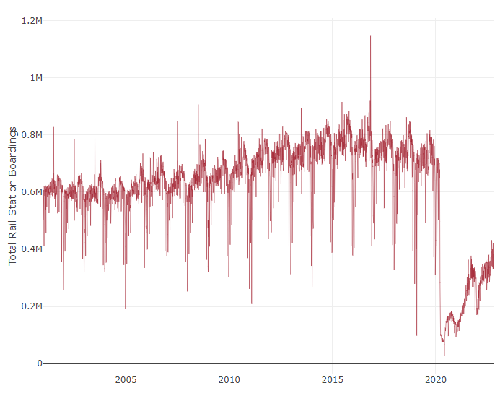
In the space below to copy/paste/insert Figure 2 or 3 from the exercise.
GEO 3330 Sustainable Urban Transportation
Exercise #2: L Station Ridership Trends
Describe patterns in rail boardings between 1999 and 2022. What do you think explains some of the cyclical variations in the data? What other factors may explain ridership over this period? Draw from the daily ridership plot to characterize ridership trends during the pandemic.
Pre- 2020 trends are indicative of common flows in the work week, with ridership peaking around the later half of the week. Periodic dips appear to correlate with national holidays/ long weekends. A gradual increase in ridership by 2015 may be a result of a stabilizing economy after the 2008 housing market crash.
Post2020 ridership seems to be heavily reflective of the various major waves of covid infections, with ridership decreasing rapidly during the initial March wave and the subsequent variant waves.

Slide 3
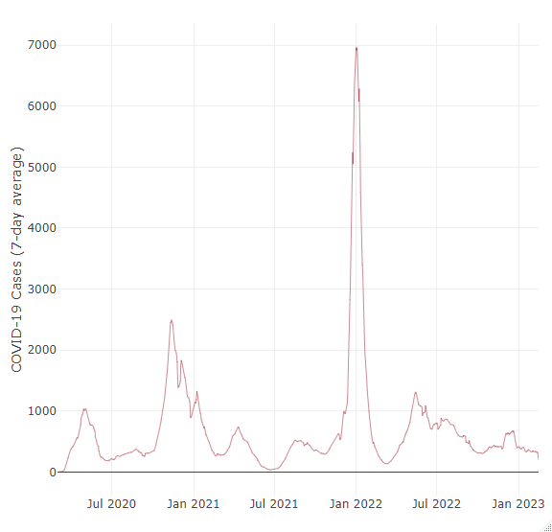
In the space below to copy/paste/insert Figure 4 from the exercise.
GEO 3330 Sustainable Urban Transportation
Exercise #2: L Station Ridership Trends
Are the waves and phases of the pandemic evident? Compare these pandemic phases to ridership trends over the same period. Do they appear to be related?
The distinct waves of COVID-19 variants are very apparent, both in the initial contraction period increase in the 7-day average as well as the subsequent post-summer/ holiday season spikes. The dips also seem to correlate to the rollout periods of the covid-19 vaccination as well.
Interestingly, while these waves are visible in the form of decreases in daily/ monthly ridership, it doesn’t seem as though the dips are proportional to the case rate. Rather, over the past 2 years ridership continually increased with brief drops. For example, during the highest point of infection in December 2021 the decrease in daily ridership was almost twice as high as the decrease in ridership during the initial outbreak of the pandemic.

Slide 4
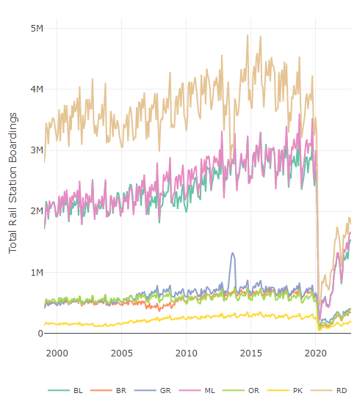
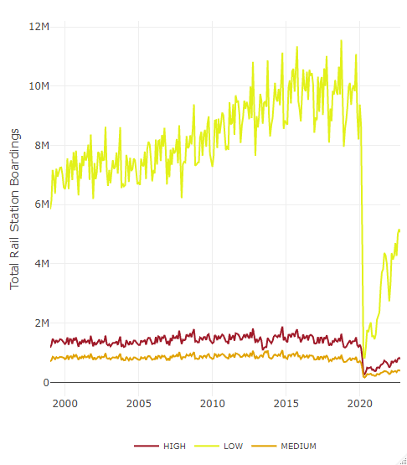
In the space below to copy/paste/insert Figure 5 or 6 from the exercise.
GEO 3330 Sustainable Urban Transportation
Exercise #2: L Station Ridership Trends
How does ridership vary with respect to station CCVI and line?
-Both figures mirror existing trends in previous graphs regarding the rate at which CTA lines were utilized pre-2020 (with the exception of summer 2013 where it appears Red line ridership decreased as green line ridership increased. I tried looking for some specific event that may have caused this but didn’t find anything about it. Looking to Figure 5, however, there appears to be a slight decrease in ridership within high vulnerability communities around the same time. This may indicate that whatever event did occur it impacted working class and marginalized communities along the Red/ Green Line the most)
- These do appear to contrast with findings in previous figures during the pandemic however. If we assume that the communities that use the CTA the most are those where economic means are few (meaning high-vulnerability communities) perhaps the more rapid return to pre-pandemic rates in low-vulnerability communities can be attributed to the following: Fastest access to vaccines, larger white collar medical professionals, and a return to air-travel (in the case of the blue line)

Slide 5
Summarize some potential short- and longer-term implications the pandemic has had on sustainable transportation and public transit ridership?
Based on these figures along with some conversations I’ve had with CMAP officials, the short term impacts of the decrease in ridership-post pandemic are dire. Due to archaic budgetary constraints and a primarily commuter-based transit system it continues to be real struggle to maintain and increase the operational capacity of the CTA. Now, with wide-spread unemployment and work from home’s rise in popularity less people have a reason to take a train system built around ferrying people from their homes to their jobs. This decrease in ridership has already led in the short term to a myriad of QOL issues across the system. From ghost trains to less eyes in the car making riding the CTA feel less safe, the transit system continues to struggle to manage even its decreased demand.
In the long term, however, this could usher in an era of serious change within the CTA. As priorities shift and the importance of public transpiration for the purpose of recreation and community development becomes more apparent, this change in ridership may for the CTA and the government to think creatively about ways to engage the public and better serve their rider’s needs.
GEO 3330 Sustainable Urban Transportation
Exercise #2: L Station Ridership Trends
What strategies do you propose to help return transit to pre-pandemic levels?
Establish a ridership safety ambassador program where community residents trained in conflict resolution skills are tasked with maintaining safety and comfort at stations and on trains to address increases in smoking, loitering, and littering on CTA cars.
Invest in housing and employment initiatives for the increased population of houseless on said trains, perhaps they can be recruited into the previously mentioned ambassador program!
Continue aggressive rehiring and improvement of CTA employee conditions to address ghost trains and busses.
Host promotional events (specialty ventra cards, anniversary events, etc.) to restore trust and pride in this civic utility.
Direct public spending towards re-imaging the role of the CTA. Question whether funds are best spent increasing access on suburban connection over inter-community connections.
Encourage integration of diverse modes of transit. Divvy bike parks are already at most CTA stations, making a greater commitment to establishing pedestrian and public transport corridors from each station makes the entire public transportation system more seamless.

